Slide 1
1.17 MULTIPLICATION RULE
From the formula (*) we will get
P(A∩B)=P(B)P(A/B) or P(B∩A)=P(A)P(B/A)
Example. There are 50 details in a box. 10 of them are nonstandard. One was drawn (A) and it was not standard. What is the probability of choosing another (B) nonstandard detail (A and B –not standart) P(A∩ B)?
P(A ∩ B)= P(A)P(B/A) = (10/50)*(9/49)
In common case if there are n -events A₁, A₂,...A_{n},
P(A₁ ∩ A₂. ∩.A_{n})=P(A₁)P(A₂/A₁)...P(A_{n}/A₁...A_{n-1})

Slide 2
Theorem. If A₁, A₂,...A_{n} are independent evens
(A_{i} ∩A _{j} =0). The event (A= One of A _{i} at least occurred =A₁ U A₂ U .. U A _{n} ; What is P(A)=?
Let is opposite event to A.
Proof:
P(A)=1- P( )=1-P ( ∩… ∩ ) =1- q₁...q _{n} , where q _{i}= P( )
Example. Let 3 hunters shooting. The probability of shooting a bird for the 1st hunter is p1=0.4; for the 2nd - p2=0.6, for the 3rd hunter it is p3=0.3. {One bullet is enough for hitting a bird} = A.
What is P(A)?
Solution: P(A)=1-q₁q₂q₃=1-0.6*0.4*0.7=0.832

Slide 3
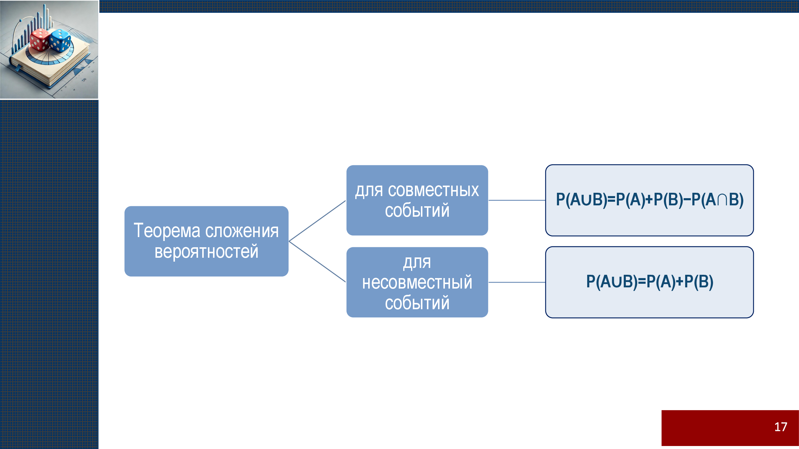

Slide 4
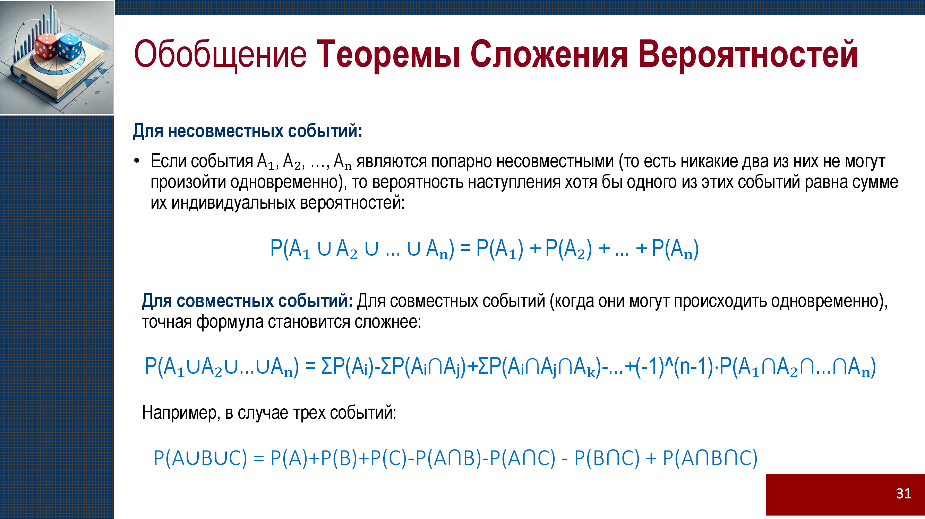

Slide 5
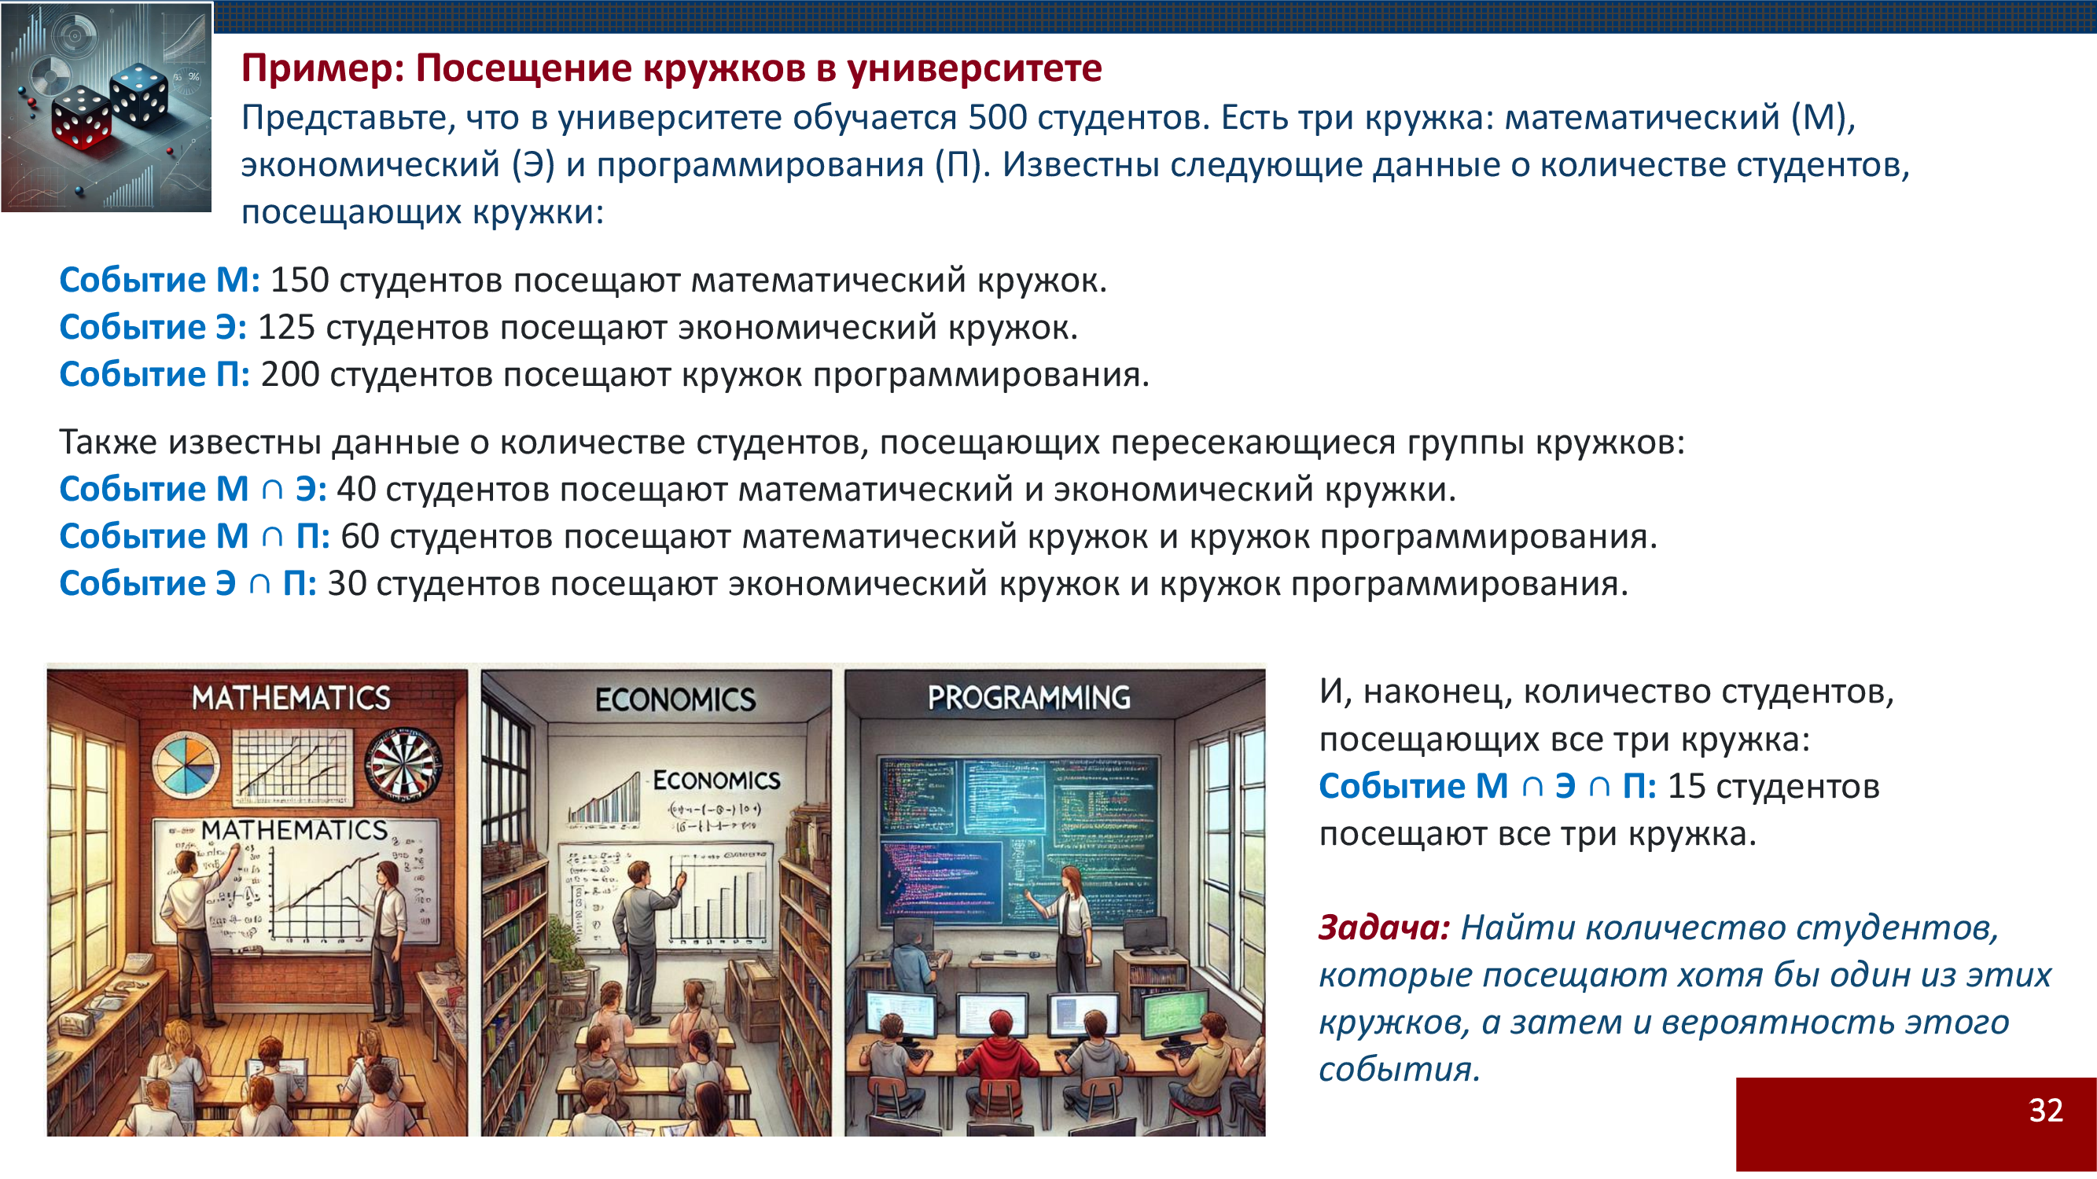

Slide 6
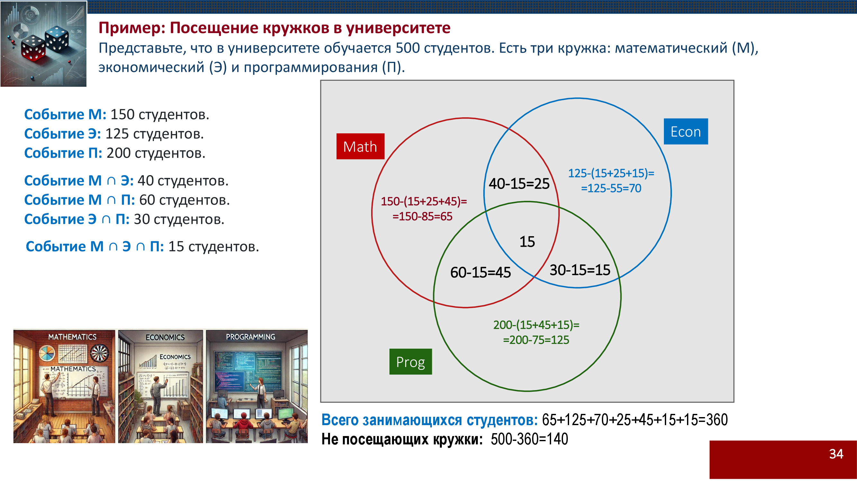

Slide 7


Slide 8


Slide 9
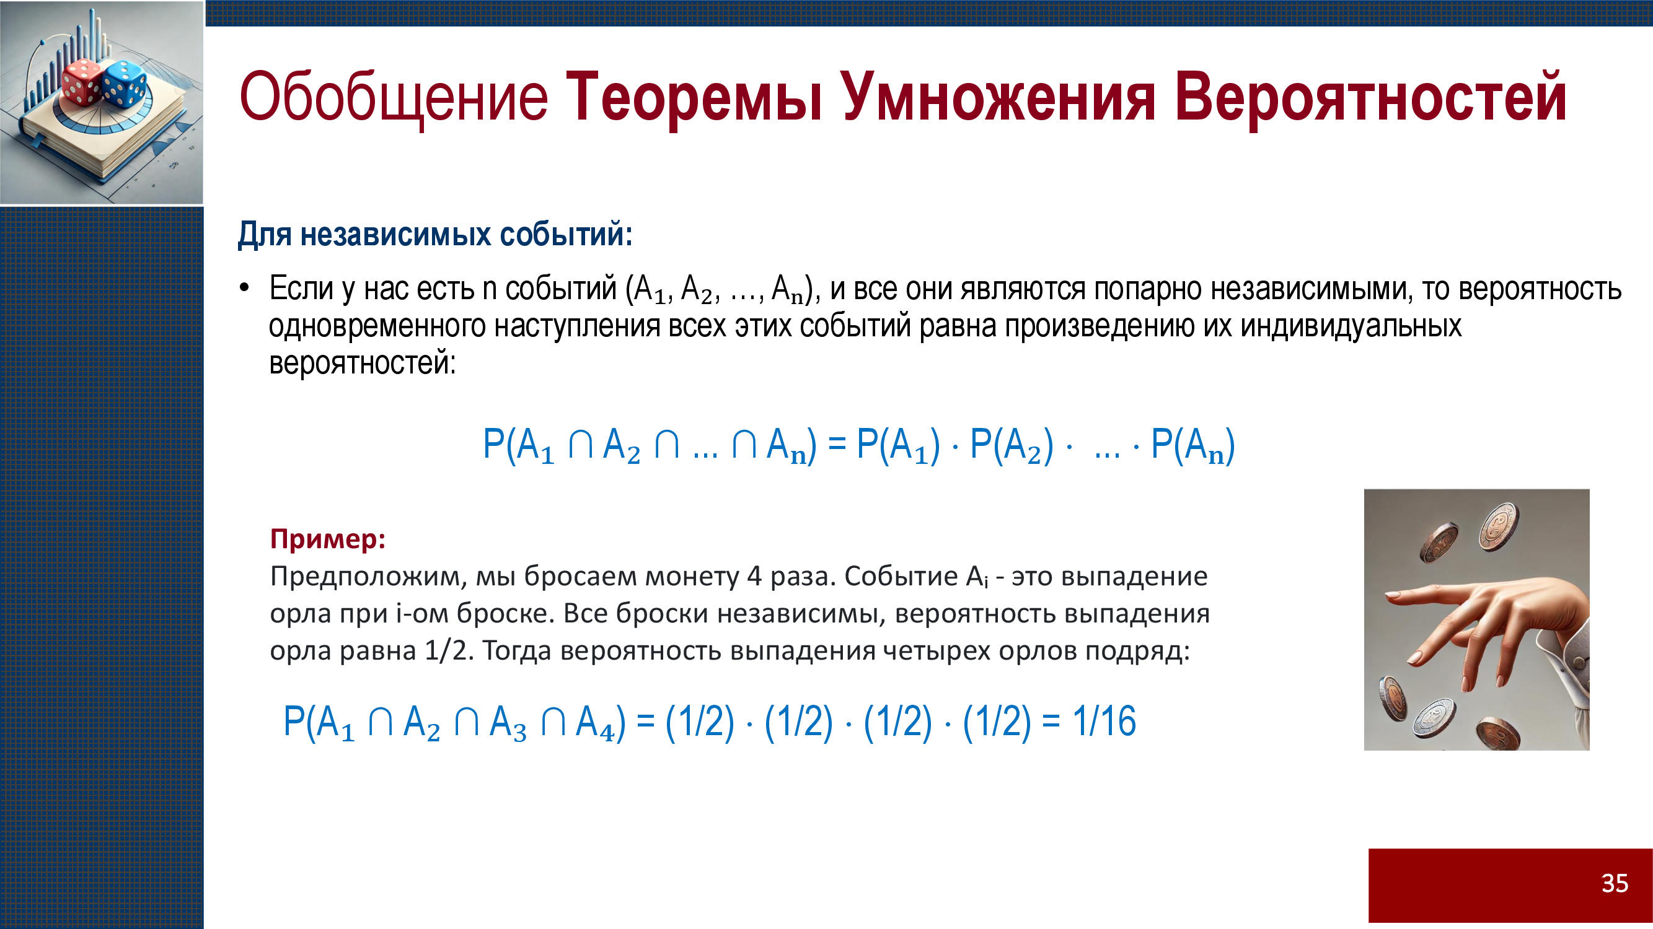

Slide 10
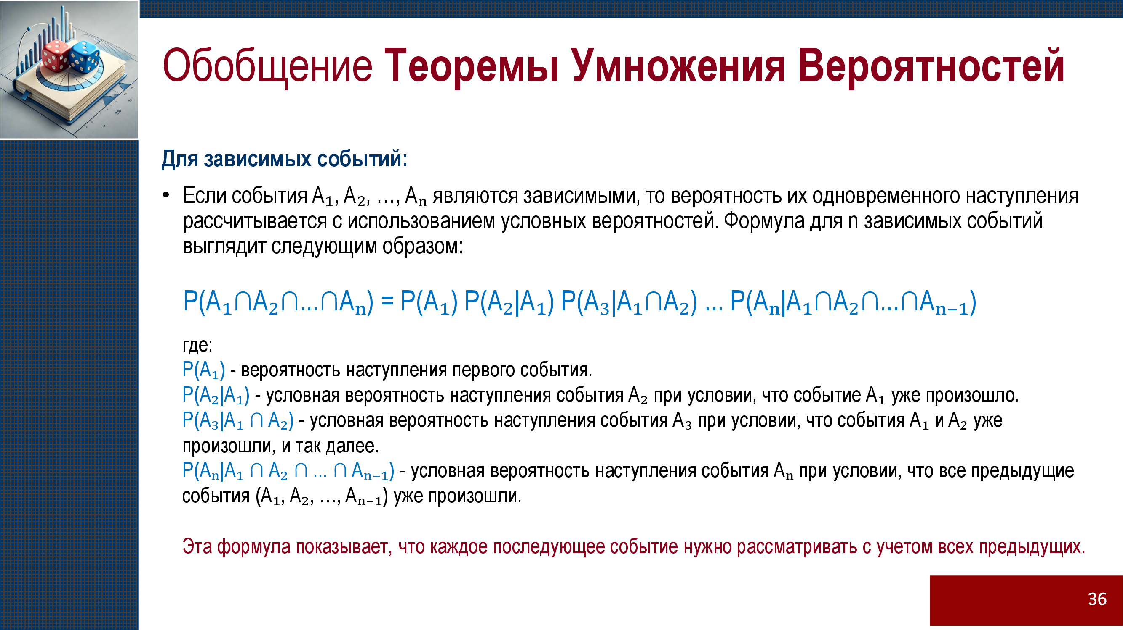

Slide 11


Slide 12


Slide 13
1.18 THEOREM ABOUT FULL PROBABILITY
Theorem. Assume that we have B₁, B₂, ...B_{n} , n-mutually exclusive events. Let’s assume that B₁, B₂,...B_{n} consists of a full group of events. A-may occur only with one of B_{i}, i=1,n.
For calculation P(A) we have
P(A)=P(B₁)P(A/B₁)+...+P(B_{n})P(A/B_{n})
Proof: A=AU= B₁ U B₂U....U B_{n} =U because of full group =A(B₁ U B₂.U....U B_{n} ) = AB₁ U AB₂.U....U AB_{n}
P(A)= P(A B₁+AB₂+..+AB_{n} )= P(A B₁)+P(AB₂) + P(AB_{n} )=
= P(B₁) P(A/B₁) +...+ P(B_{n}) P(A/B_{n})

Slide 14
Example. There are 3 plants. They produce lamps. Let’s
1st plant produces 10% of nonstandard products, Prob=0.1
2nd plant produces 5% of nonstandard products, Prob=0.05
3rd plant produces 15% of nonstandard products, Prob=0.15
1st plant produces 50% of all, Prob= 0.5
2nd - 30% and Prob=0.3
3rd - 20% of all the lamps. Prob=0.2
Solution:
A-an event of buying nonstandard lamp.
B₁-an event of producing in the 1st plant
B₂- an event of producing in the 2nd plant
B₃₋ an event of producing in the 3rd plant
We should use the formula
P(A)=P(B₁)P(A/B₁)+...+P(B_{n})P(A/B_{n})
In our case n=3, P(A)=P(B₁)P(A/B₁)+...+P(B₃)P(A/B₃)
P(B₁)=0.5, P(A/B₁)=0.1 etc. P(A)=0.5x0.1+0.3x0.05+0.2x0.15=0.095͌⁓ 0.1

Slide 15


Slide 16
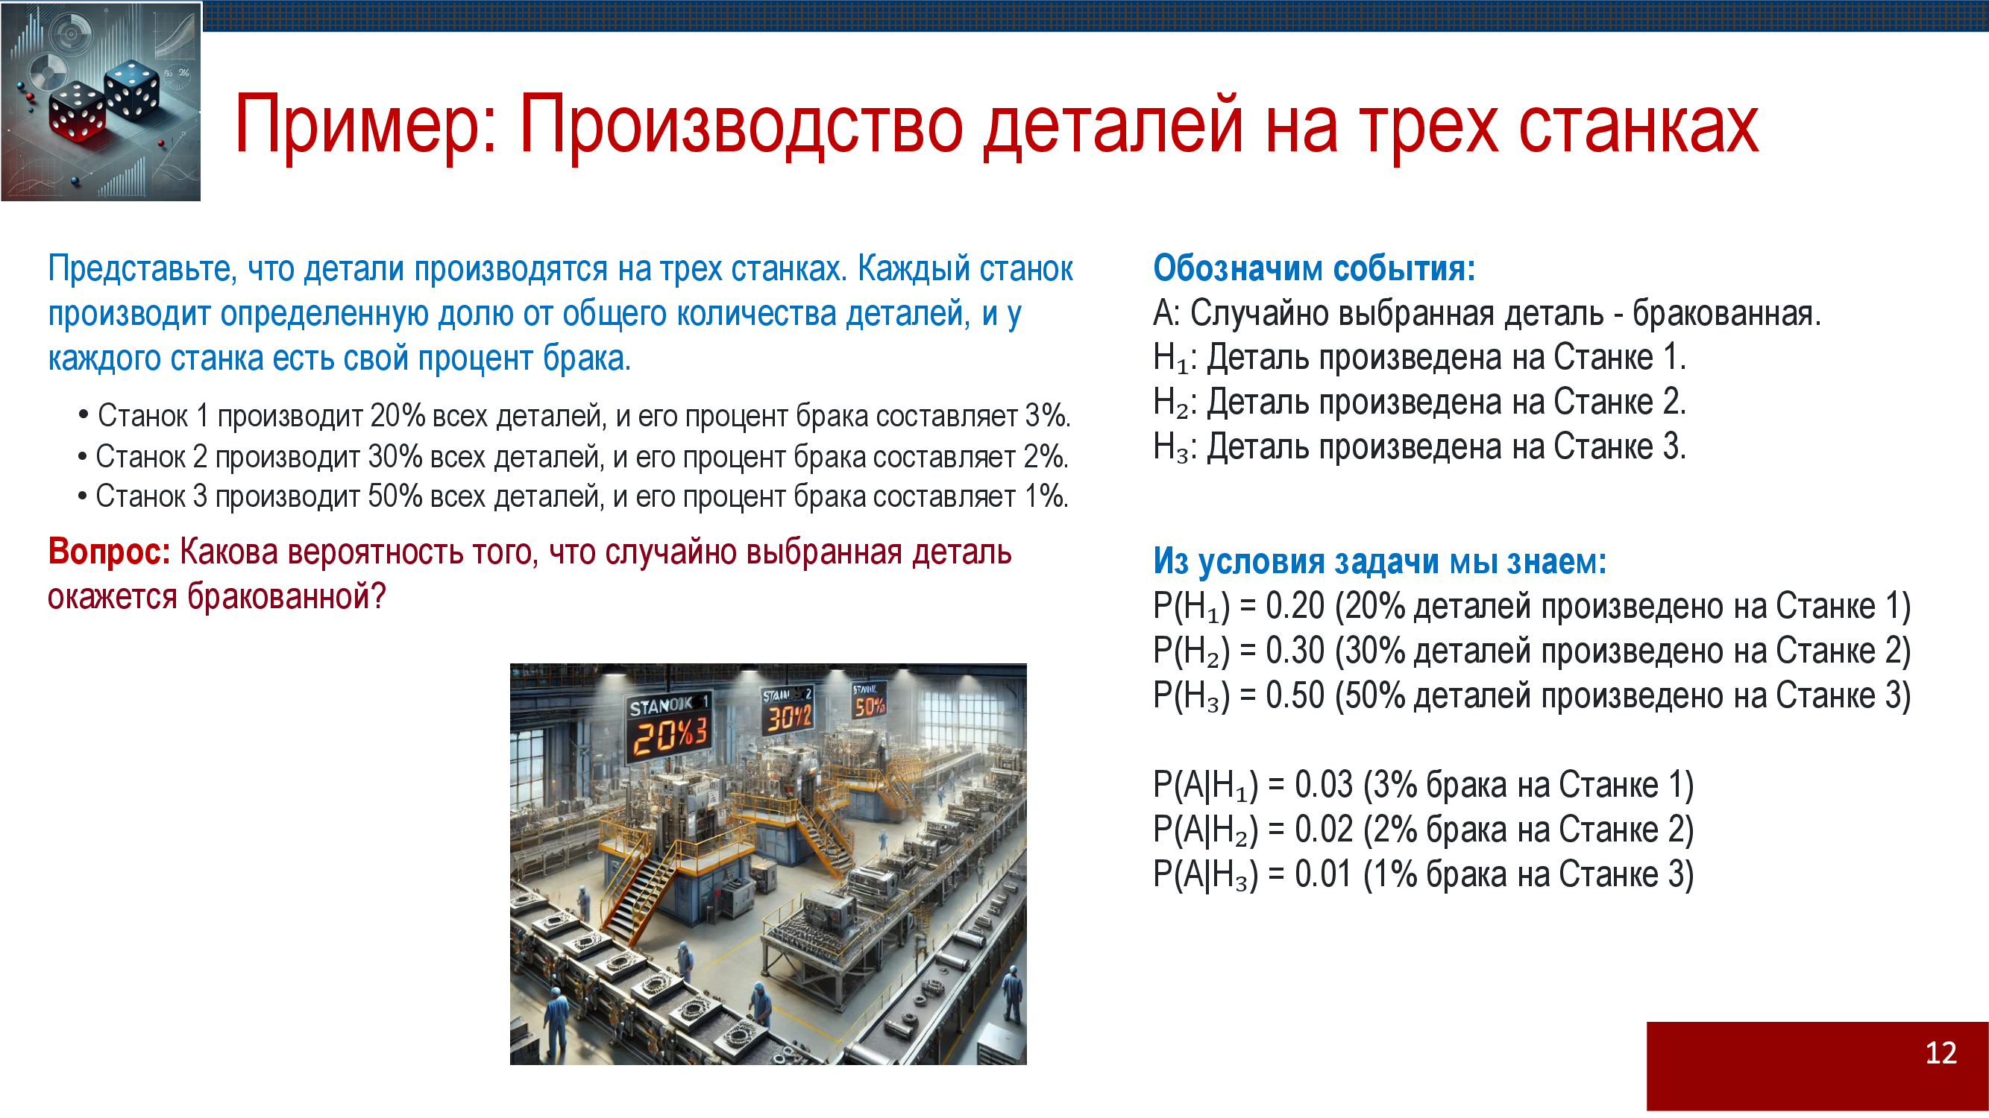

Slide 17
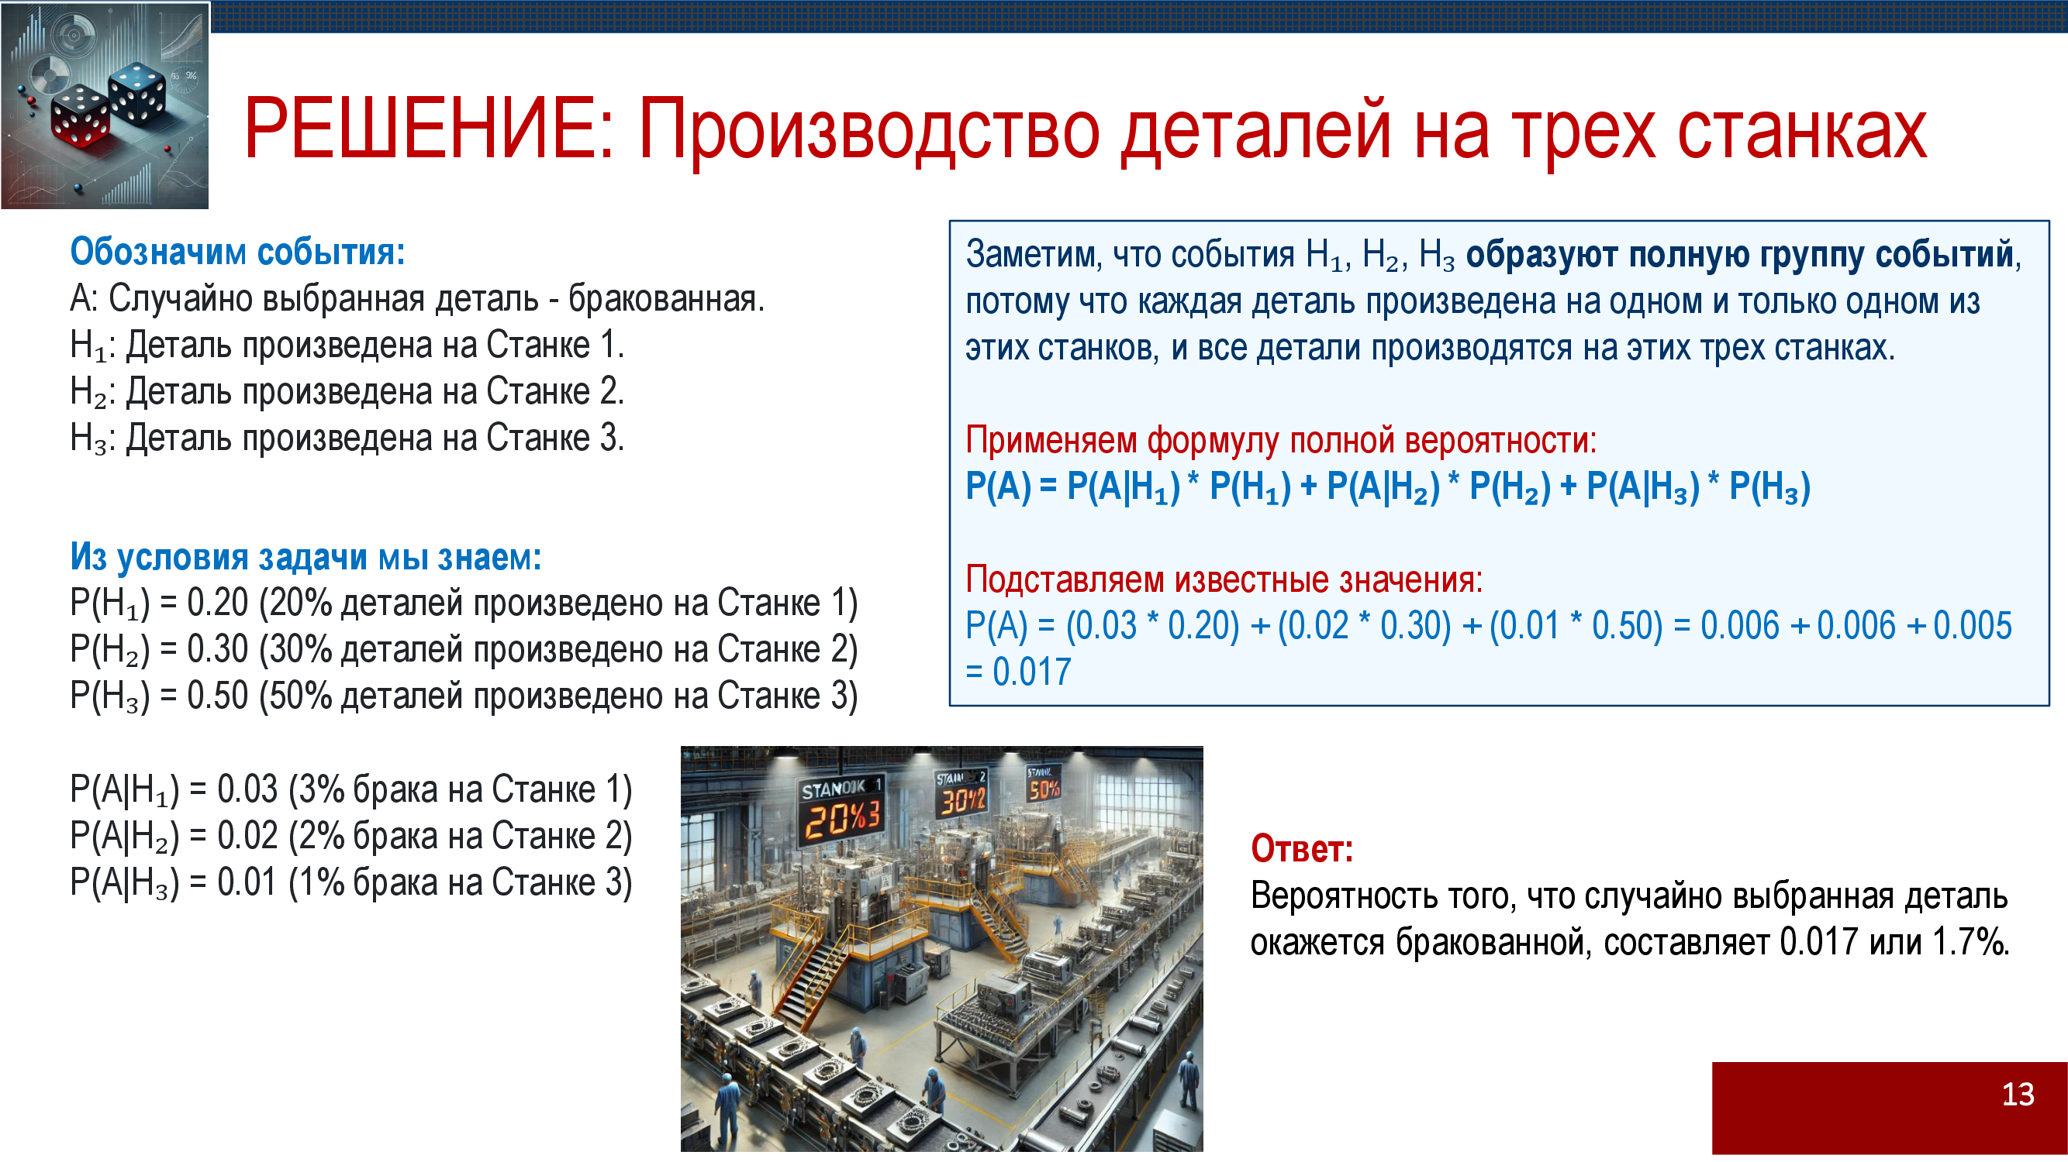

Slide 18
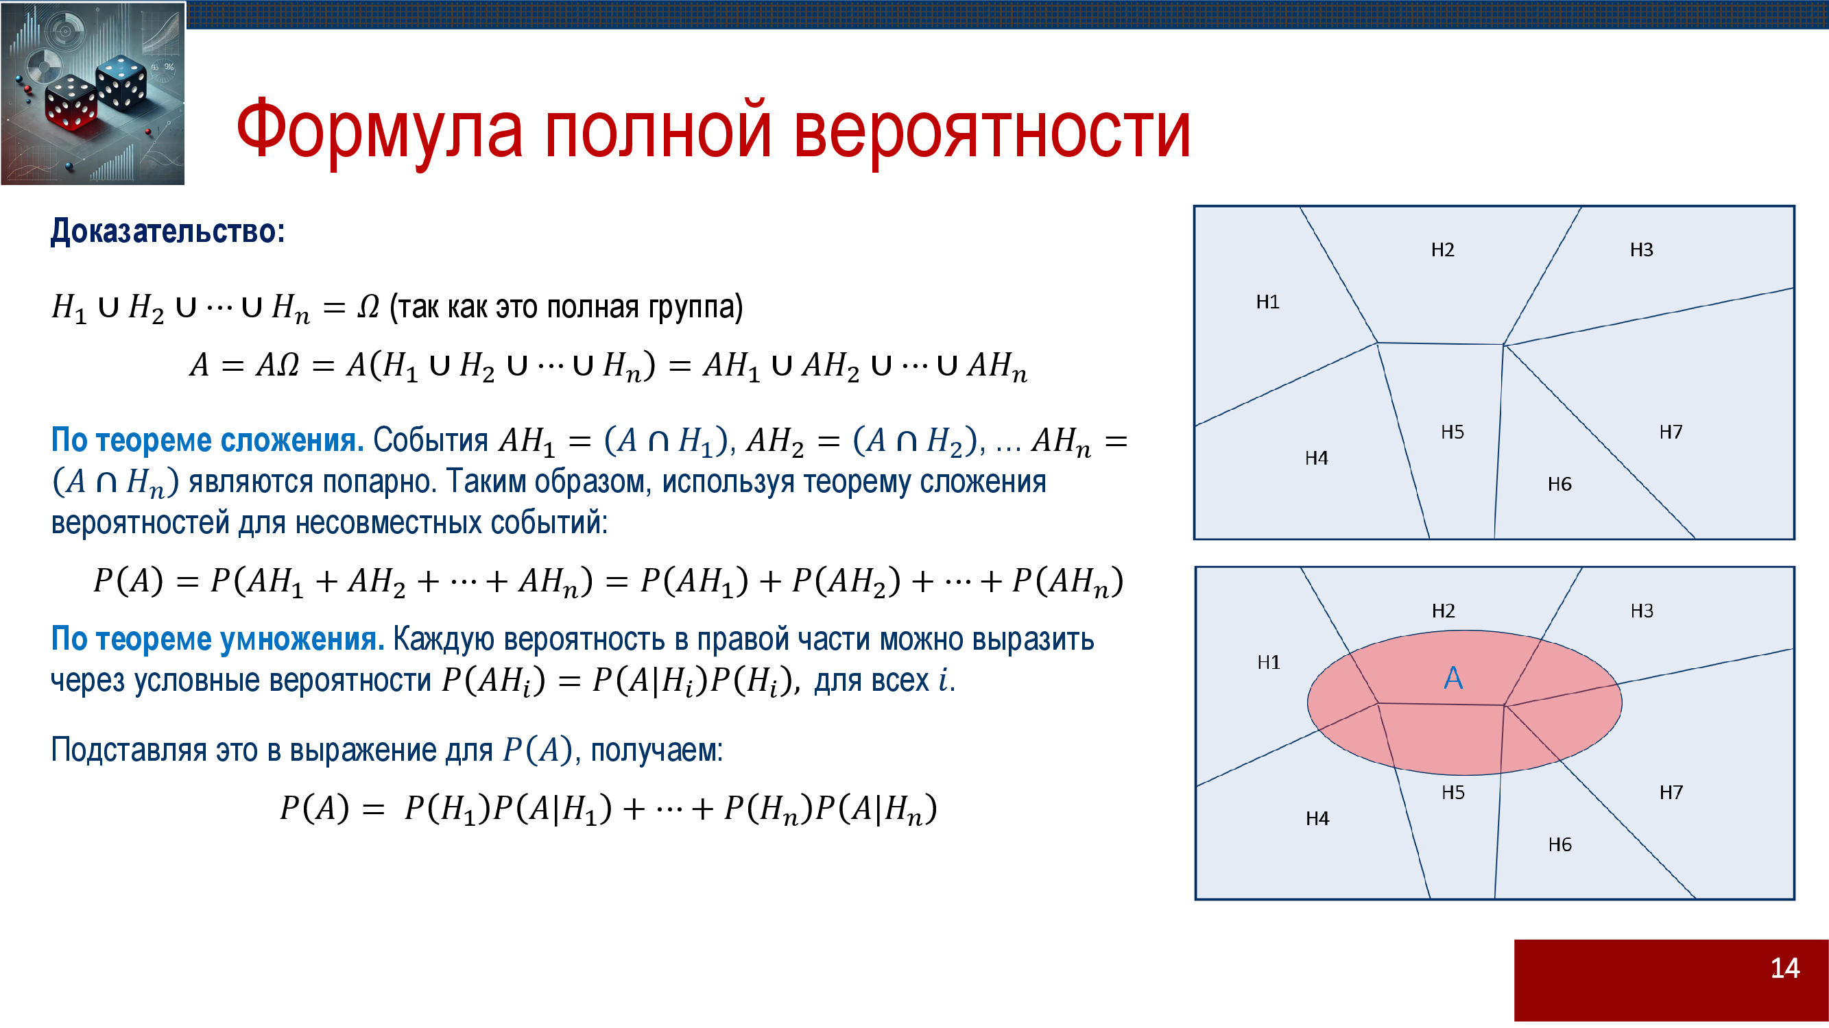

Slide 19
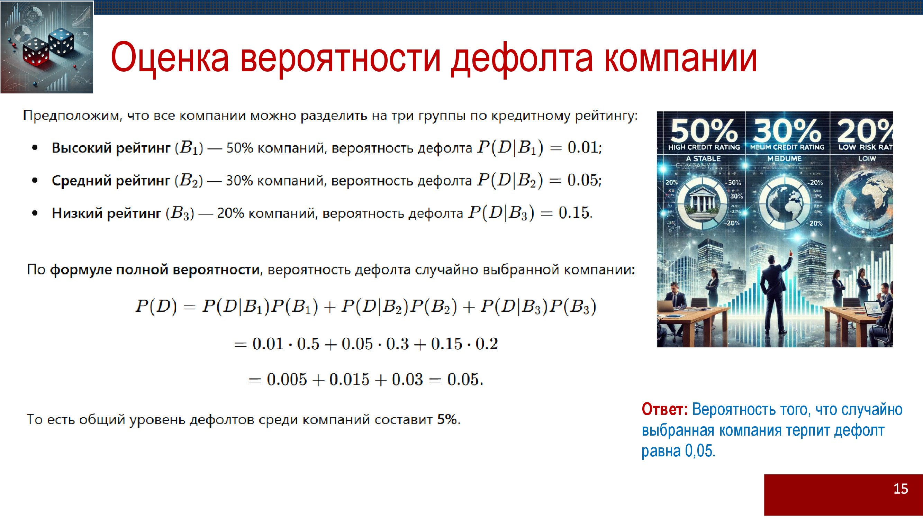

Slide 20
1.19 BAYES THEOREM (BAYES LAW OR FORMULA)
Theorem. Let’s B_{1,} B₂,...B_{n} be mutually exclusive events.
A is an event for which P(A)≠0, then the conditional probability P(B_{i}/A) for any of events B_{i} , given that A has already occurred is given by
P(B_{i}/A) = P(B_{i})P(A/B_{i}) / P(A)=
P(B_{i}) P(A/B_{i}) / P(B_{i}) P(A/B_{i})
Proof.
P(AB_{i})=P(A) P(B_{i}/A) = P(B_{i}) P(A/B_{i})
Calculate P(B_{i}/A) using conditional probability.
P(B_{i}/A)= P(B_{i})*P(A/B_{i}) / P(A)

Slide 21
Example. The automatic machines produce similar parts. Machine A produces 40% of the total products, B-25%, C-35%. On the average, 10% of the parts turned out by A do not conform the requirements(i.e. defected), for B and C these are 5% and 1% respectively. If one part is selected randomly from the combined output and is found not to conform the requirements, what is he probability that the part is produced by machine A?
P(A/D)=?
D is the event of selecting a defected part.
We need to calculate P(A/D)=? .
P(A/D)=(P(A)P(D/A))/P(D), P(D)=P(A)P(D/A)+P(B)P(D/B)+P(C)P(D/C)
In our case:
P(A)=0.4; P(D/A)=0.1; P(B)=0.25; P(D/B)=0.05; P(C)=0.35; P(D/C)=0.01; P(A/D)=0.714 ; P(A/D) ⁓ 71.4%.
Machine A produces 71.4% of the defected parts.

